Slide 1

Python project High-level programming language
By: Hamilton conceicao

Slide 2
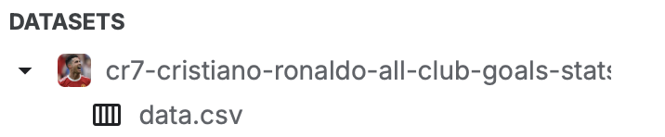
DataSet Overview
I found this data in Kaggle, this dataset contains all the stats of all club goals of Cristiano Ronaldo dos Santos Aveiro, while playing for Manchester United.
Cristiano Ronaldo dos Santos Aveiro is a Portuguese professional footballer. when this data created, he was playing as a forward for Premier League club Manchester United and captain the Portugal national team.
This an international level Data, However, it was sourced in the UK England
Geographical analysis of Ronaldo's goals across various leagues and countries, such as England, Spain, Italy, Saudi Arabia and competitions like UEFA Champions League and international matches.
The Dataset contains columns such as; Season(goal id), Competition, Matchday, Date, Number/Name of competition and Goals.

Slide 3
Data Structure
This Dataset contains,710 rows and 13 columns, the also contains, Categorical, Numerical and Date/Time data types.
The data covers approximately 21 years of Cristiano Ronaldo's club career.
This dataset can be used for a wide range of analyses and insights, such as Goal scoring analysis, career progression and longevity, time -series analysis, historical comparisons geographical and more.

Slide 4
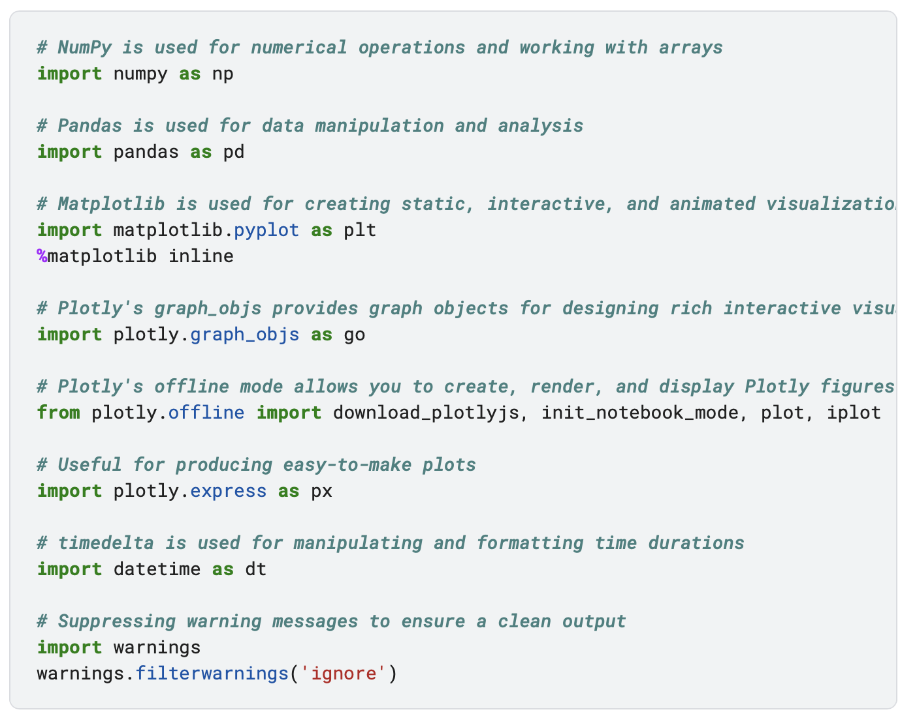
Data loading and Inspection IMPORTING LIBRARIES

Slide 5
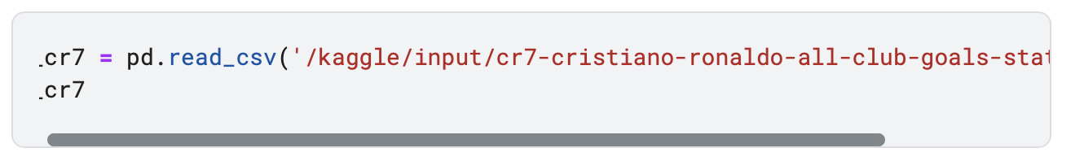
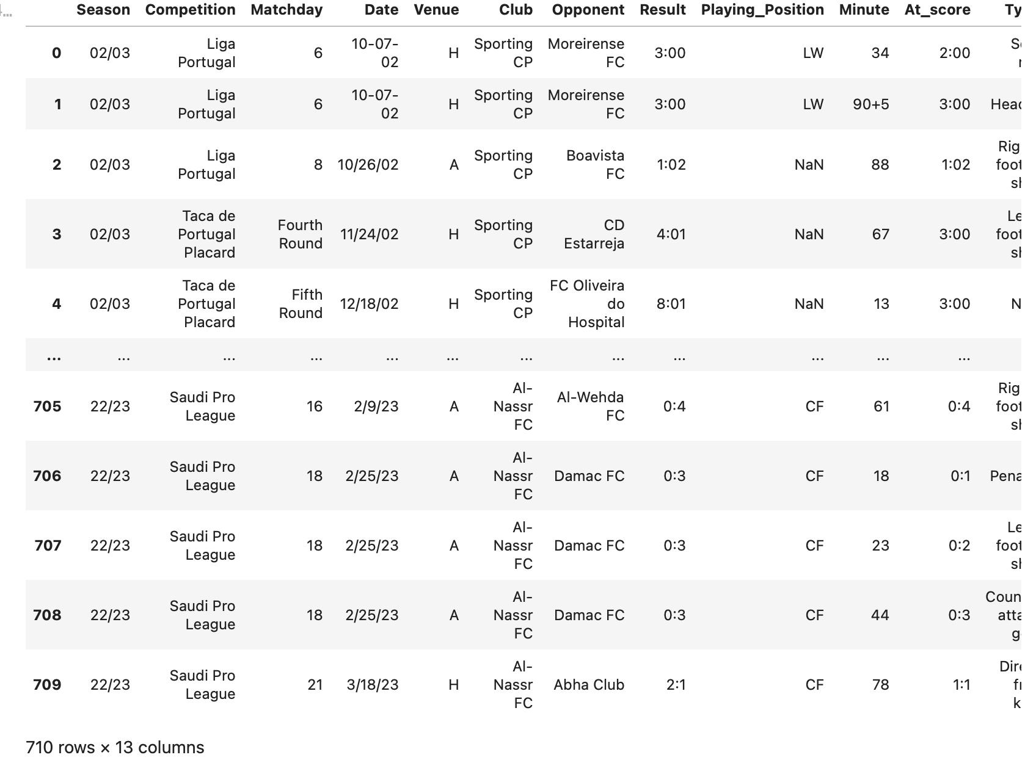
Loading my data using pandas

Slide 6
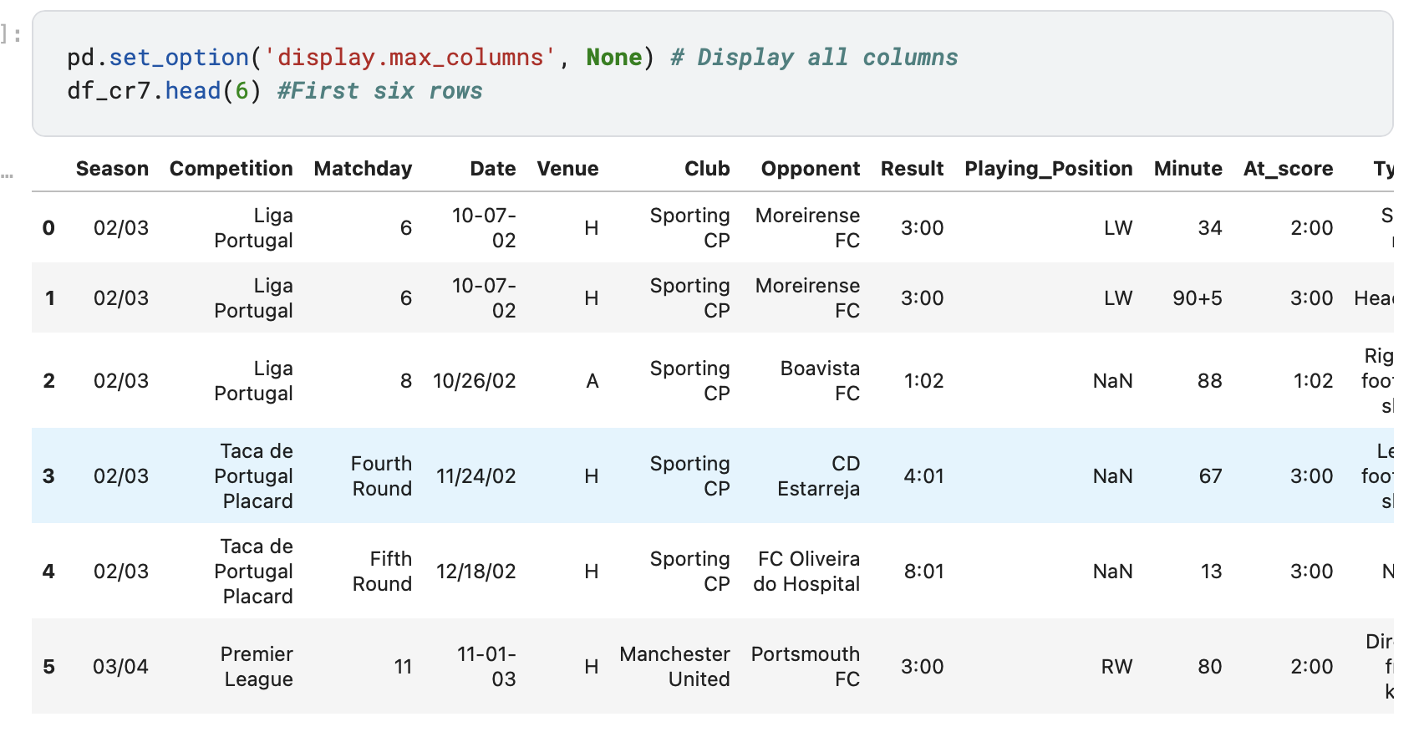
INSPECT THE DATASET

Slide 7

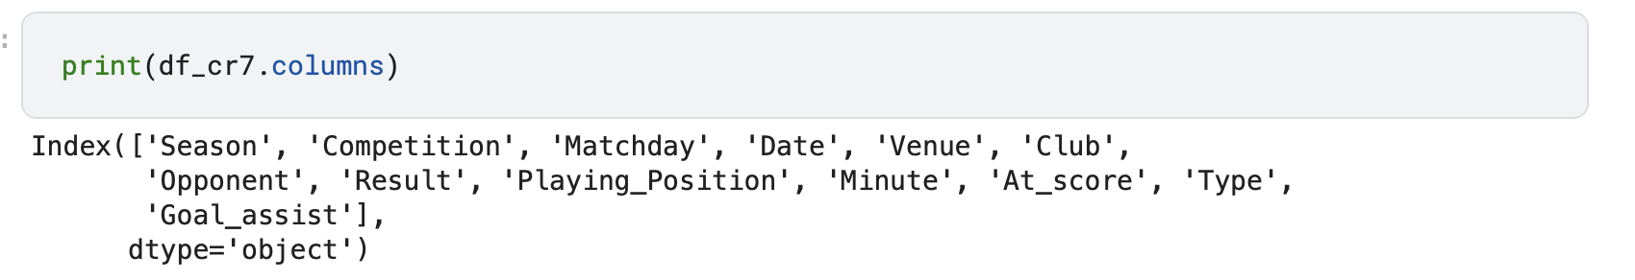
Still Inspecting…

Slide 8
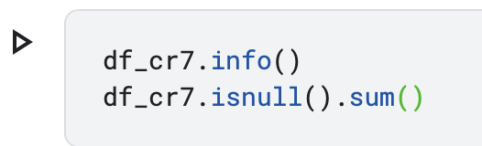
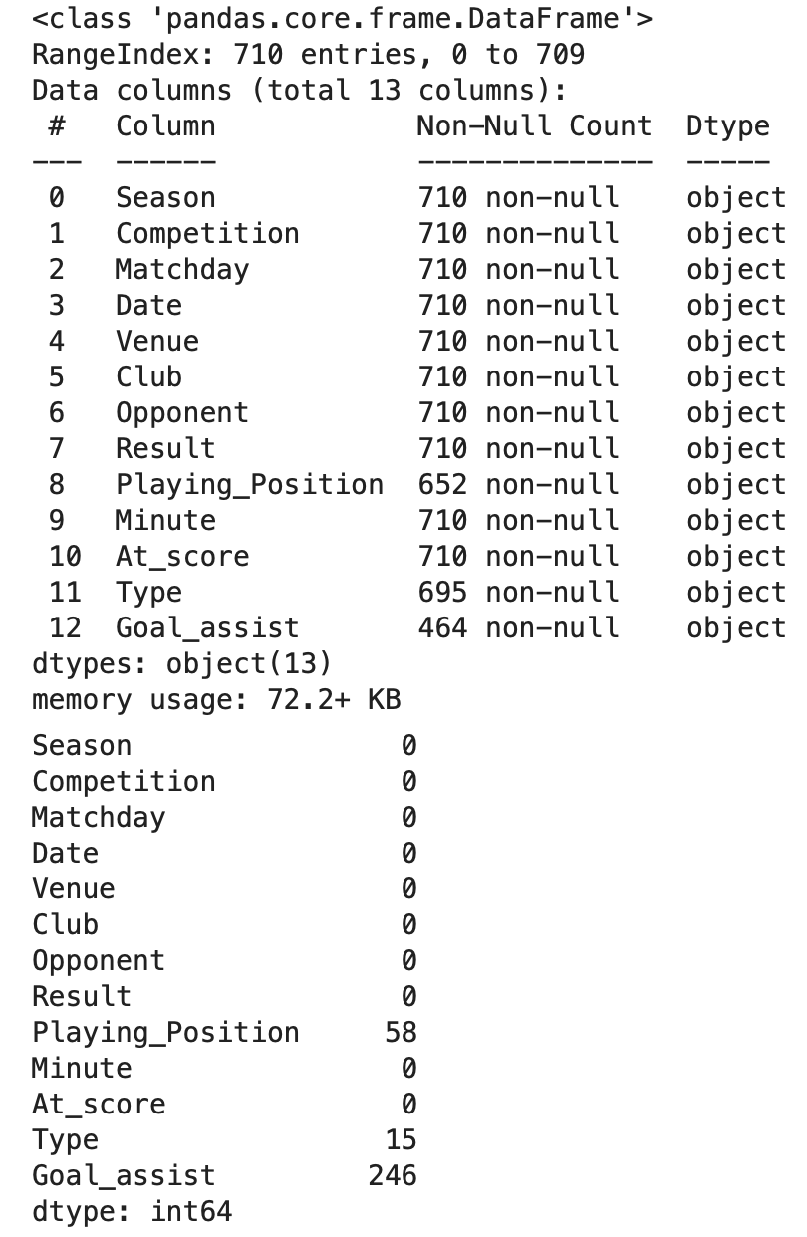
CHECK DATA TYPE AND NULL VALUES

Slide 9
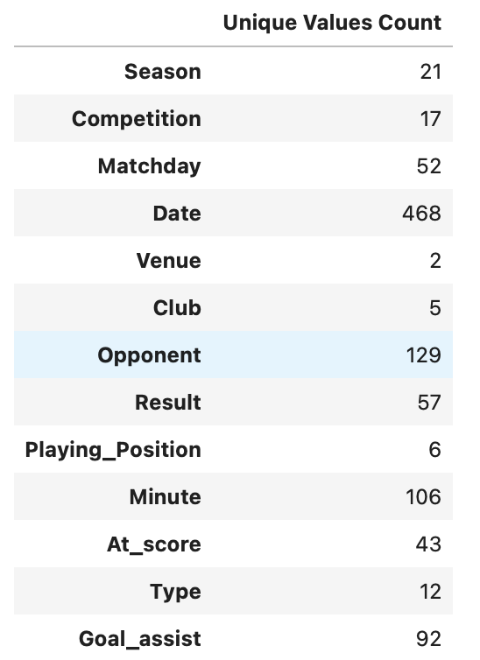

Slide 10
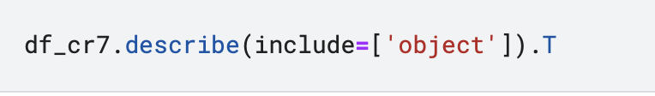
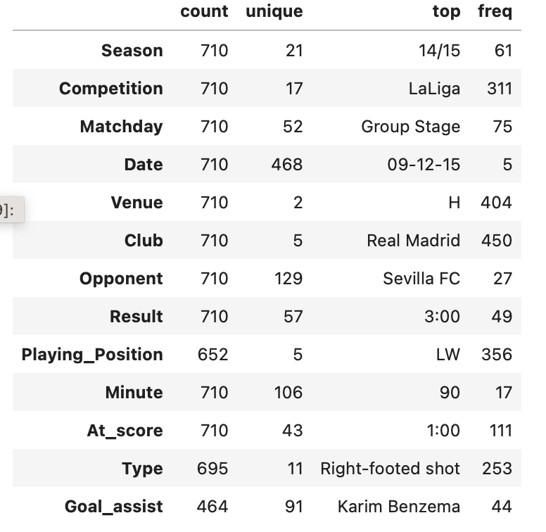

Slide 11
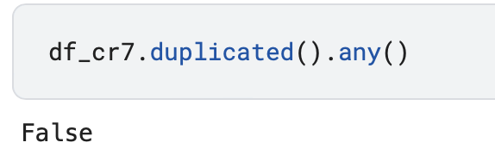
This Dataset contains 710 entries with 13 columns, and the info() function gives an overview of the non-null counts.
TOTAL NULL VALUES
Playing Position: 58 null values
Goal assist: 246 null values
Type: 15 null values
All columns are currently classified as object data type, which generally means they are being treated as strings(text data) in Pandas.

Slide 12
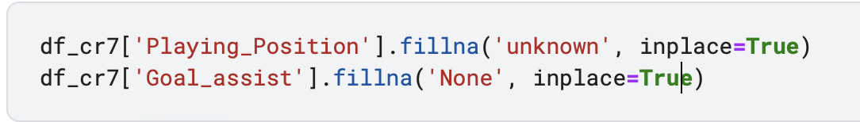
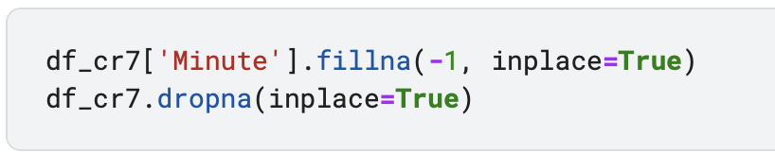
DATA CLEANING Handle missing data Drop and fill missing values based on the nature of your dataset:

Slide 13
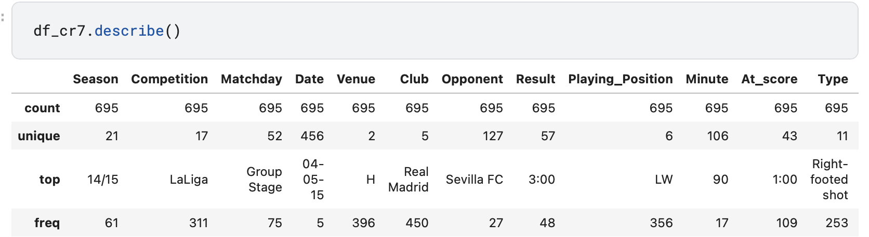
EXPLORATORY DATA ANALYSIS (EDA) Summary statists of numerical columns

Slide 14
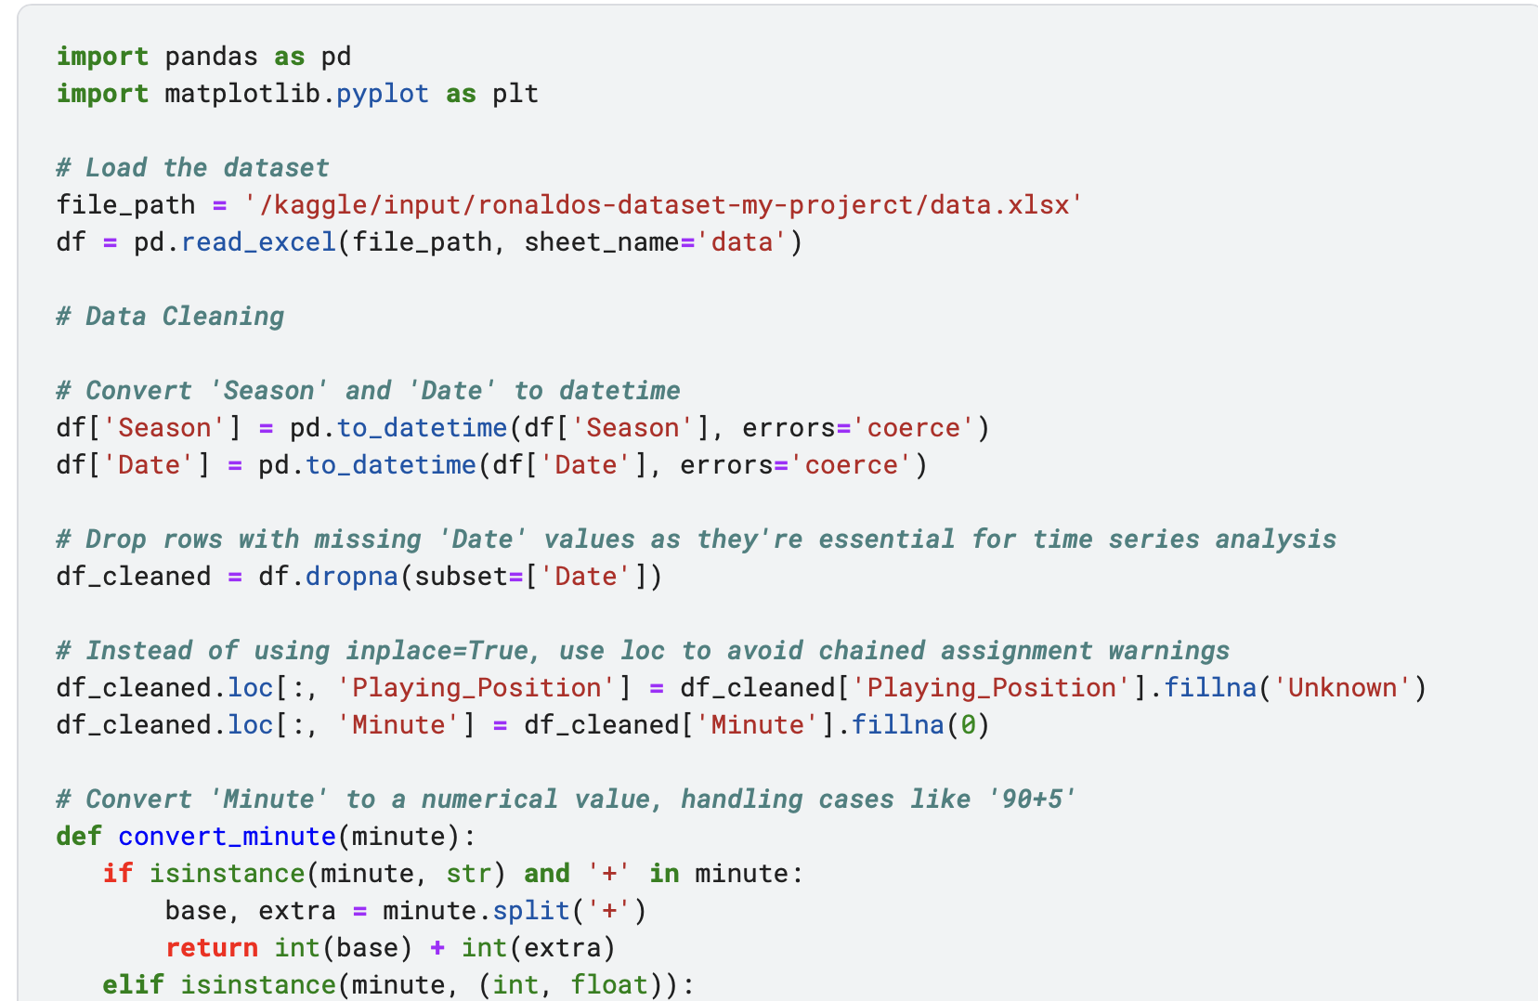
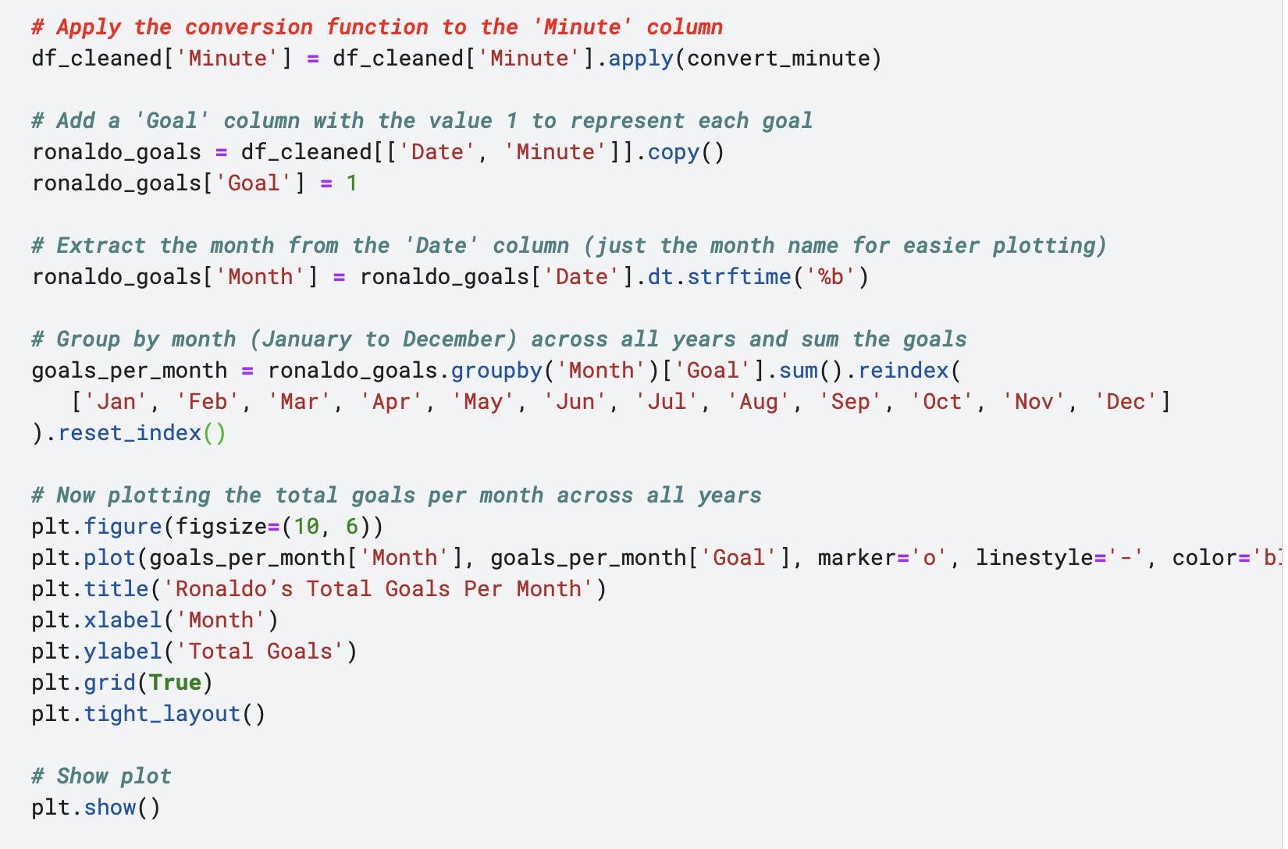
DATA VISUALISATION USING MATPLOTLIB Plot a line graph (for time-series data)

Slide 15


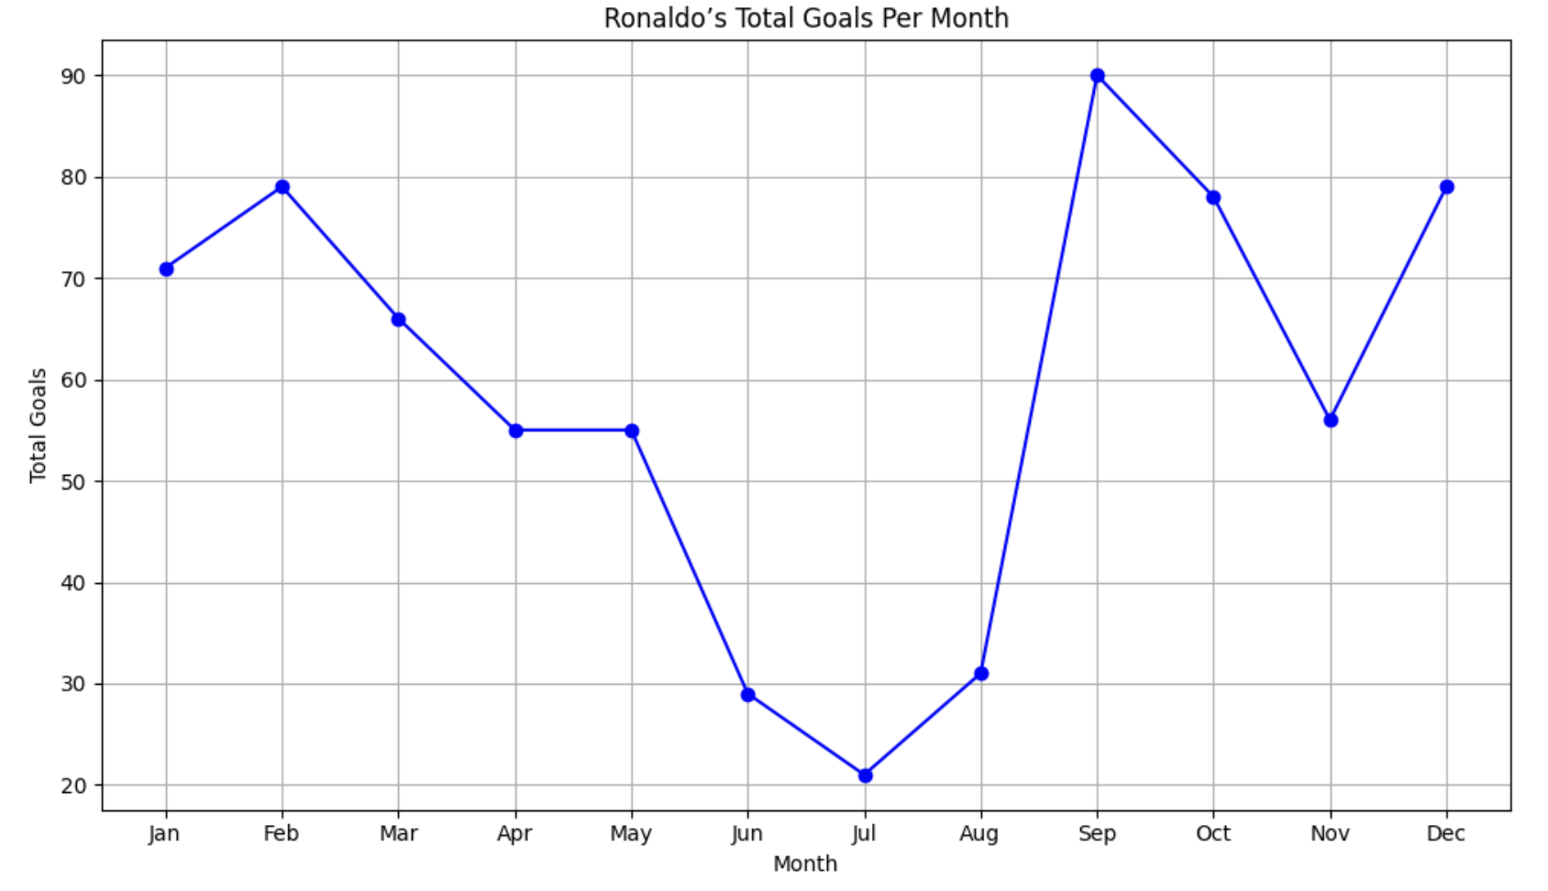

Slide 16
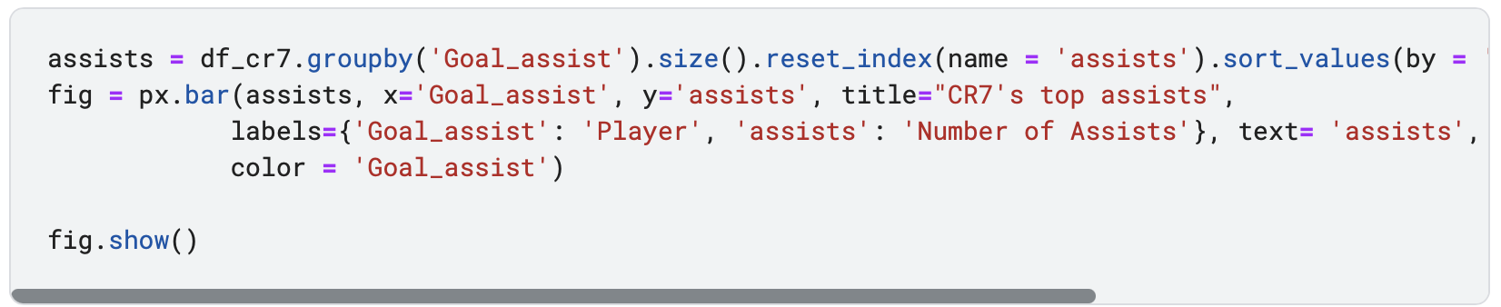
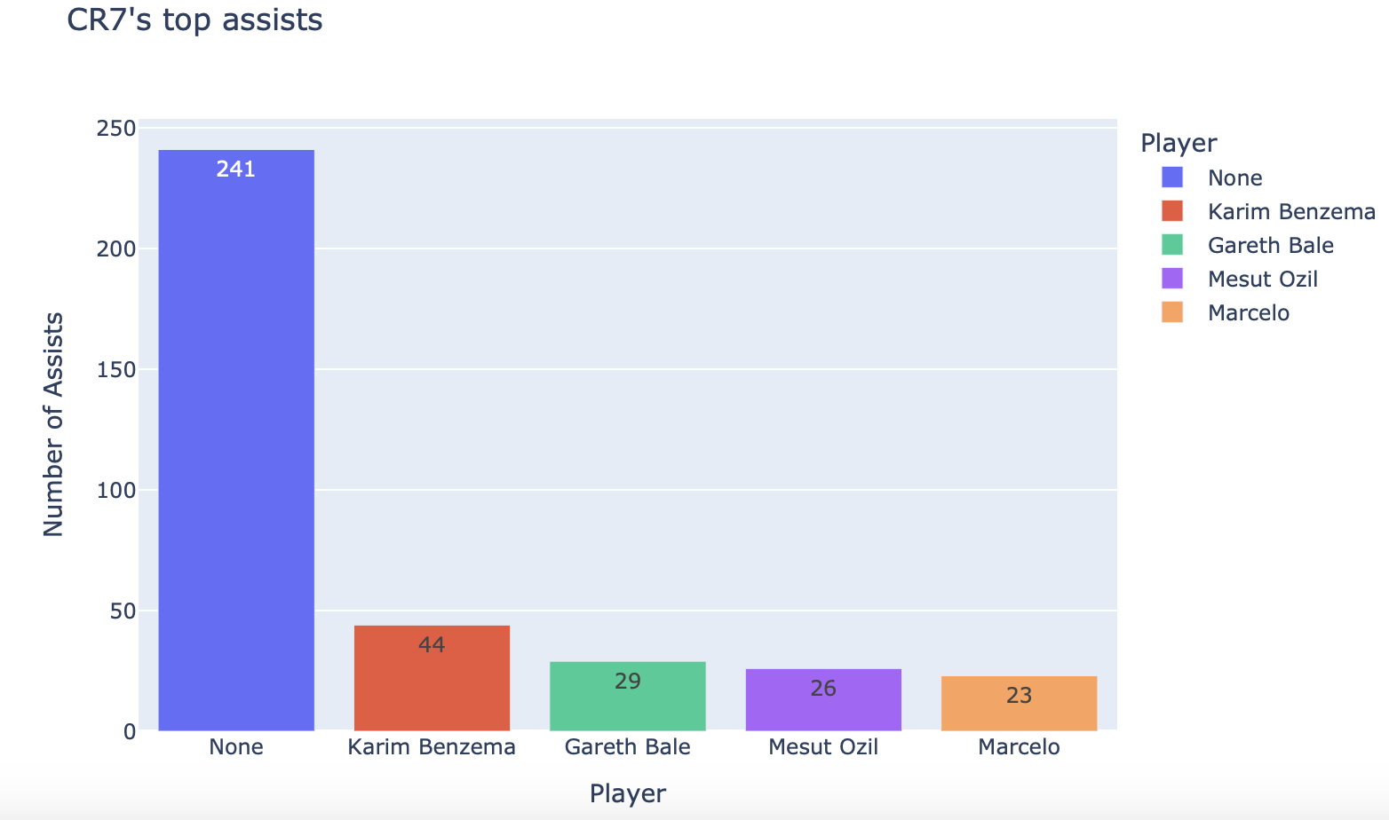
Plot Bar chart

Slide 17
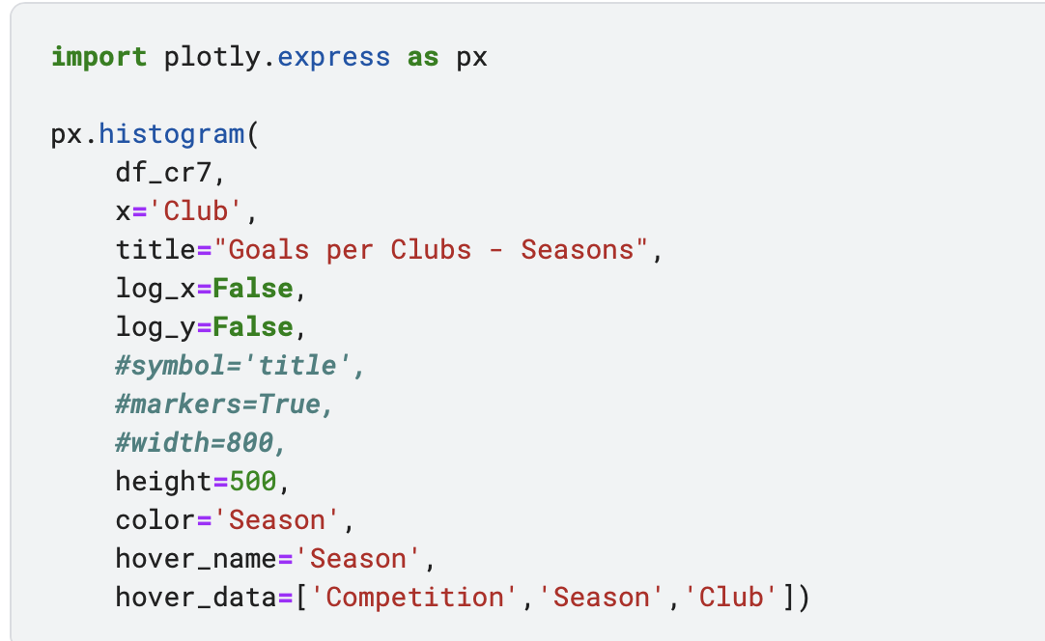
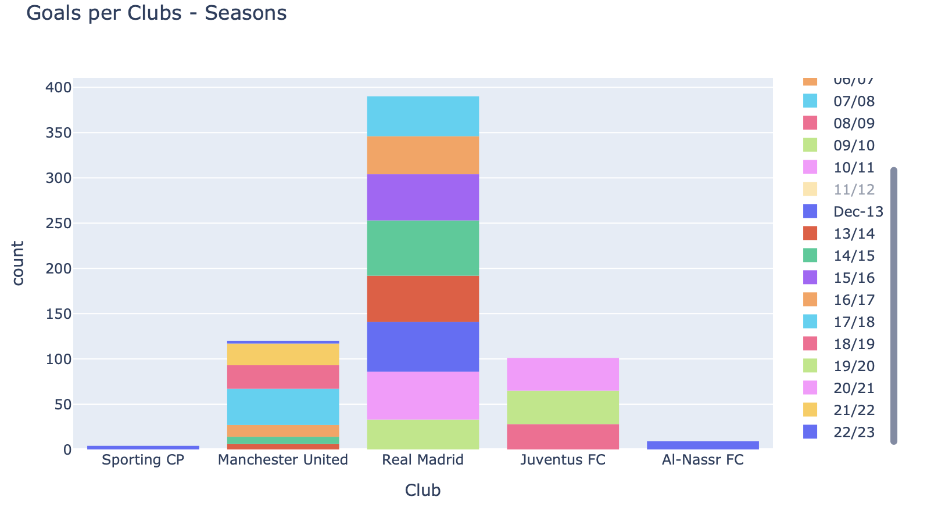
Plot Histogram

Slide 18
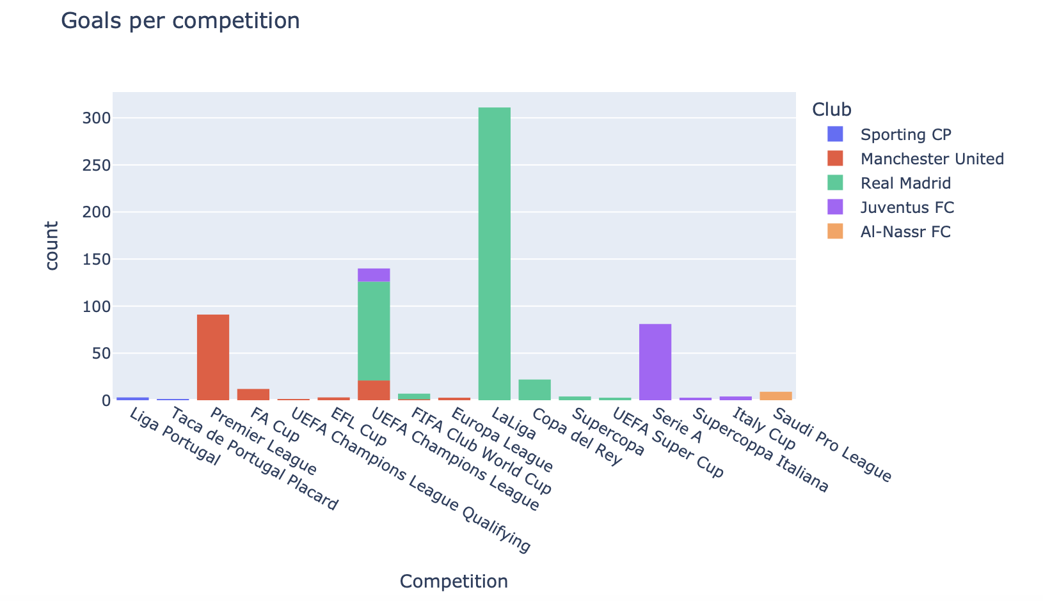

Slide 19
Summary of Insights
This workflow introduces learners to real-world Data analysis and visualization, using Pandas, Matplotlib.
-Goals scored per season: the visualization allows for a clear understanding of his career evolution in terms of goal-scoring, with Real Madrid being the most productive period of his career.
-Goal-scoring peaks: These could correspond to particular stages in Ronaldo's career where he was playing in high-powered teams or in prime physical condition.
-Goal distribution across competitions: Certain competitions or leagues might show a higher rate of goals, which could be linked to either the quality of opponents or Ronaldo's playing style fitting specific tactical setups.
-Impact of the time on performance: The rolling averages and overall trend lines may indicate how Ronaldo's effectiveness in front of goal evolved over time, potentially highlighting the inevitable impact of aging on his athletic abilities.

